Slide 1
Agentic AI Hackathon: Building Intelligent Agents with IBM Granite and LangFlow
Intelligent Patient Vital Monitoring and Alert System

Slide 2

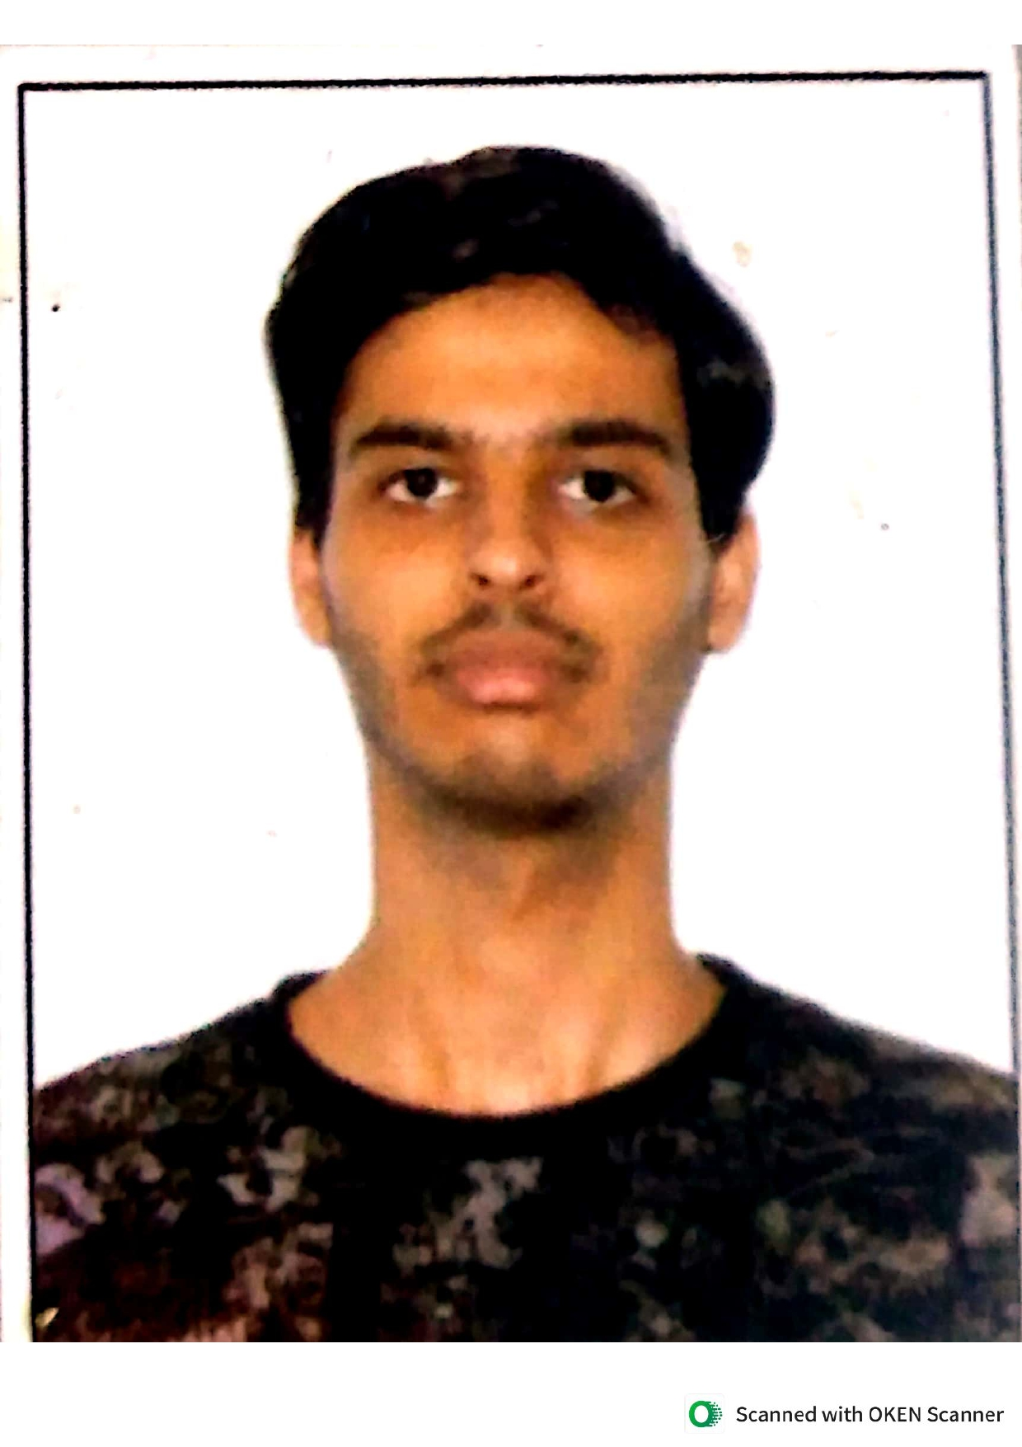

Name of the team: Code Blue
Details of Team members
TEAM MEMBER NAME | Recent Passport Photo | Email ID | Phone number [WhatsApp]
Rajashree Shankara Narayana |  | rajashreeshankara.ai23@bmsce.ac.in | 63610 73975
Aryan Kumar |  | tassithakur@gmail.com | 79033 26072
S. S. Gokula Swamy |  | gokulaswamyss@gmail.com | 9900054954

Slide 3
Problem statement
Problem Statement 7: Intelligent Patient Vital Monitoring and Alert System
The Challenge
Continuous monitoring of patient vital signs such as heart rate, blood pressure, oxygen saturation, and temperature is critical in preventive healthcare. However, healthcare staff cannot manually monitor real-time vital data for multiple patients simultaneously. This increases the risk of delayed response to early signs of health deterioration. An intelligent assistive system is required to continuously analyze vital signs and flag potential risks in advance.
Vital Data Analysis Agent
An agent that processes continuous or periodic vital sign data and summarizes patient health status trends.
Anomaly Detection Agent
An agent that identifies deviations from normal vital ranges using historical baselines and guideline-based thresholds.
Alert & Care Guidance Assistant
An agent that generates alerts and provides general care guidance based on detected anomalies
(assistive only, non-diagnostic).
Outcome
Improves early risk detection and supports timely clinical attention and patient safety.
Mandatory Tech Stack
Lang Flow using IBM Granite Model
(Using RAG on standard vital ranges and preventive care guidelines.)

Slide 4
Proposed solution
Basically, we upload the patient’s information periodically to the model.
The vital information of the patient is compared against standard ranges from a guideline file.
Then detects anomalies and computes risk guiding on non-diagnostic alerts and suggestions that clinicians can implement.
The Proposed solution in a concise way can put as follows:
An integrated LanFlow and IBM Granite pipeline that uses RAG on vital sign guidelines to analyze periodic patient vitals and compute a weighted risk score and display non-diagnostic alerts and guidance to aid in early risk detection and clinical attention

Slide 5
Need of project
This project is needed to bridge the gap between continuous vital-sign data and timely clinical action by providing an intelligent, guideline‑based monitoring assistant that detects early risk, prioritizes patients, and supports overburdened healthcare staff without making formal diagnoses.
The Major Factors which compel the existence of this project are
Continuous Monitoring Gap: Less Doctors and More Patients , So wrong diagnosis and errors in assessment are prone to happen in that tense environment between life and death
Early warning = better outcomes: The earlier the diagnosis of the disease or condition the survival chances are better.
Scalability to remote monitoring: The project can be extended to telemedicine and remote patient monitoring with an addition of an expert database and rules.

Slide 6
End user of project
Primary Users
ICU or Ward Nurses and Healthcare Technicians
Physicians and Medical Officers
Hospital administrators and Quality Managers
Secondary Users
Telemedicine /Remoted Monitoring Centre's
Clinical Research and development of better models

Slide 7
Technology Used
Langflow platform : DataStax Astra – Visual Workflow builder to connect components.
Langflow component name
    1. Chat Input/Output : User Interaction
    2. Read File : Loads medical guideline file for RAG context (file.txt)
    3. Prompt Template : Injects guidelines and patient vitals to the Granite prompt.
    4. IBM Granite API Component : Custom Component to use Granite model on IBM Cloud.
    Custom Components
    5. Risk Stratification Calculator and Summary of trends
IBM Granite model : ibm/granite-3-8b-instruct.
IBM Cloud : Authentication of API key and Project ID
RAG : Vital sign normal ranges stored in file.txt, read at runtime and passed as {context} to the prompt.
Python : Used in Risk Stratification component.
.

Slide 8
Novelty and Uniqueness
LLM Driven Clinical Reasoning and not value based threshold alone
Combined Risk and Trend View in one Report
      - Weighted risk score
      - Guideline Based severity
      - Baseline comparison and percentage change trends
      3. Custom Risk Stratification Engine on top of the LLM output : Converts qualitative LLM judgements into a numeric and interpretable risk score(0-100%).
      4. Explainable and Non-Diagnostic by design
      5. Uses a lightweight file.txt guideline document as knowledge base.
      6. Modular LangFlow Architecture : Easy to debug and scale up.

Slide 9
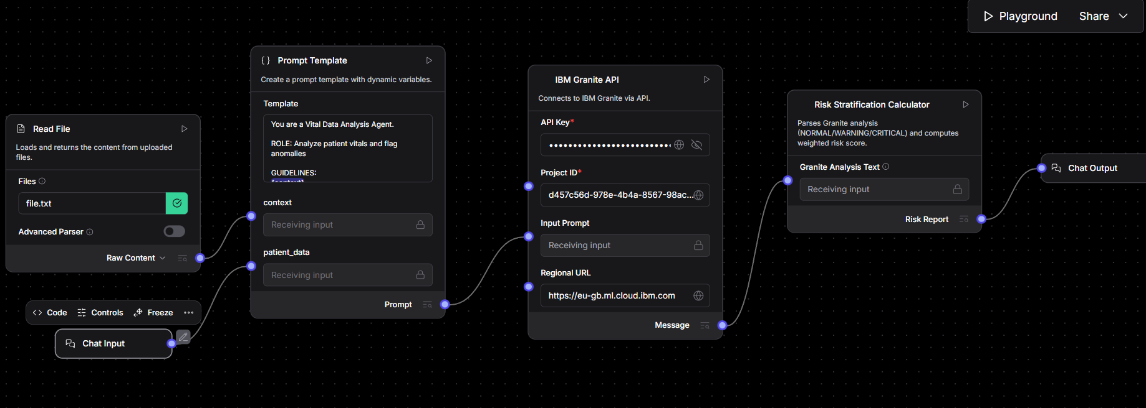
Technical flow diagram - Architecture blueprint

Slide 10
Langflow component Used
1. Chat Input
- Captures patient details and vital signs from the user.
- Acts as the starting point for every analysis request.
2. File Component (Read File)
- Loads `file.txt` containing medical vital‑sign guidelines and normal ranges.
- Provides this text as **context** (RAG) to the Prompt Template.
3. Prompt Template
- Merges:
- Medical guideline context from the File component
- Patient vital data from Chat Input
- Creates a structured prompt for the IBM Granite model (analysis + anomaly detection + care guidance).
4. IBM watsonx / Granite AI Agent (Custom Component)
- Calls the IBM Granite model (`ibm/granite-3-8b-instruct`) on IBM Cloud.
- Sends the prompt from the Prompt Template and returns the LLM’s analysis of the vitals.
5. Risk Stratification Calculator (Custom Component)
- Reads Granite’s text output and extracts the status for each vital (NORMAL / WARNING / CRITICAL).
- Computes a weighted risk score and classifies the patient into GREEN / YELLOW / ORANGE / RED risk zones.
- Appends a short baseline/trend summary to the final report.
6. Chat Output
- Displays the final combined message to the user:
- Vital sign assessment
- Risk stratification result
- Trend summary and assistive care guidance.

Slide 11
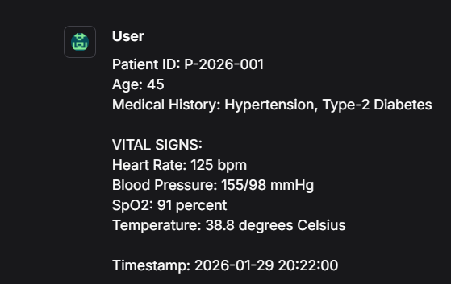
Input Screenshot

Slide 12
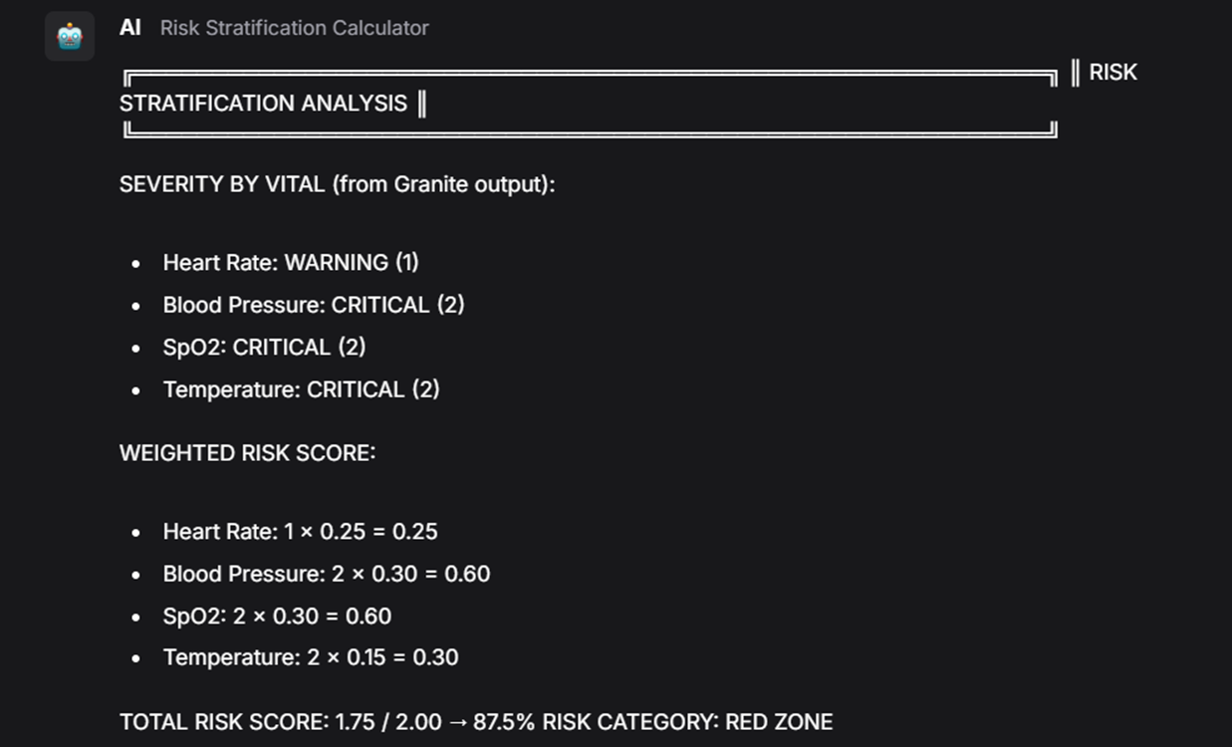
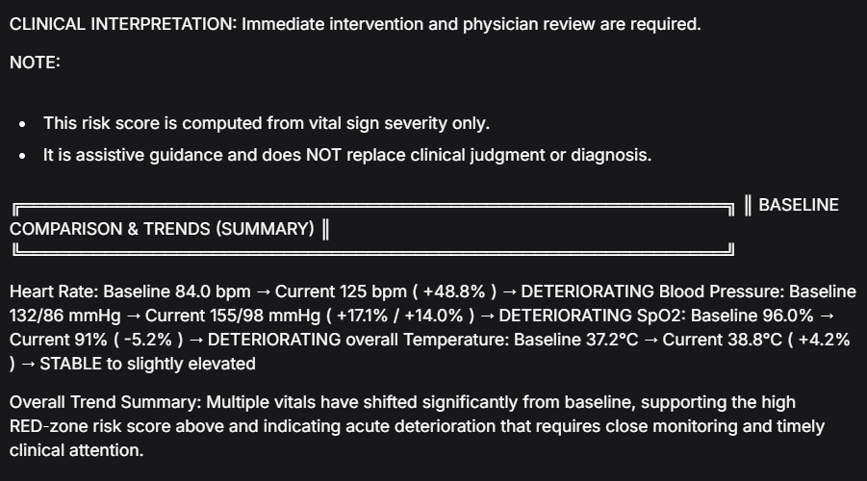
Output Screenshot(Critical)

Slide 13
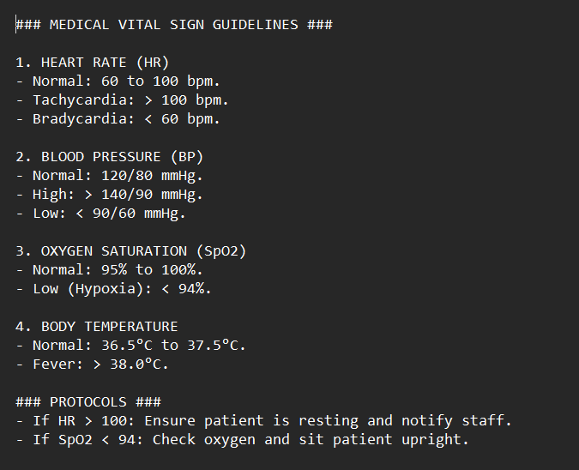
File.txt

Slide 14
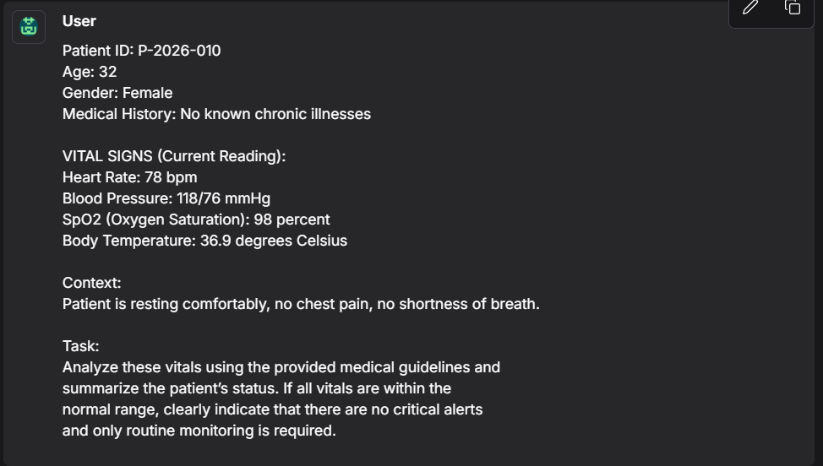
Input Screenshot 2

Slide 15
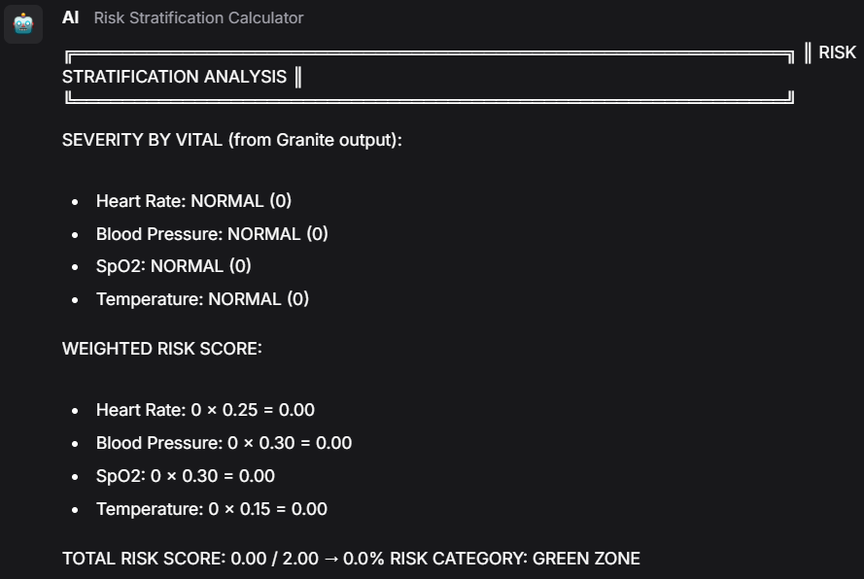
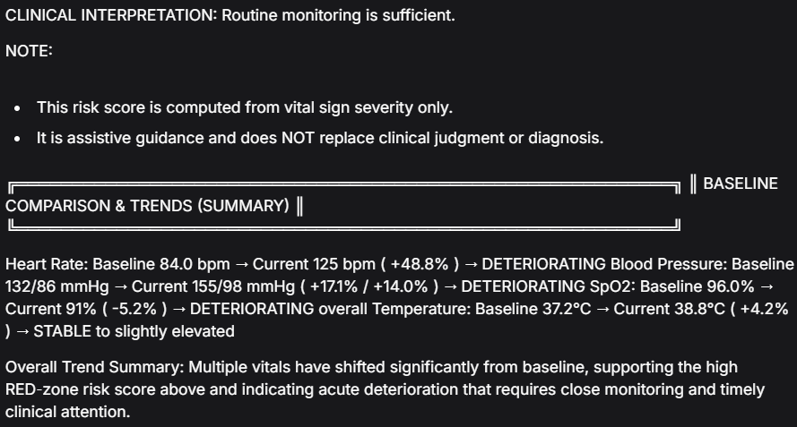
Output screenshot (Normal)

Slide 16
Future Scope
·1. Integration with Real Hospital Systems
2. Support for more Vitals and Clinical Data
3. Patient Specific Learning and Adaptive Baselines
4. Predictive Early Warming Models: Train ML models on historical data to predict deterioration 1-6 hours in advance.
5. Multi Patient Dashboard and Alert Prioritization
6. Deployment for Remote Monitoring
7. Multilingual and Voice Interface
8. Clinical Validation and Regulatory Readiness
·
·
·

Slide 17
Git Hub Link
· Please create public github repository (Enable Add README button while creating repository) with format –
Please test and Paste the working Github URL –
https://github.com/Lion4467cat/patient-vital-monitoring
·
·
·

Slide 18
References
IBM watsonx.ai – Granite Models
  IBM Granite 3‑8B Instruct model overview and API usage.
  https://www.ibm.com/products/watsonx-ai
LangFlow Documentation (DataStax Astra)
  Building and deploying LLM pipelines with components likeChat Input, File, Prompt Template, and Custom Components.
  https://docs.langflow.org
IBM Cloud – Machine Learning & AI Services
  Platform used to host and call the Granite model via REST API.
  https://www.ibm.com/cloud
Standard Clinical Vital Sign Ranges
  General reference for normal HR, BP, SpO₂, and temperature ranges.
  Example summary: https://www.ncbi.nlm.nih.gov/books/NBK541070/
Early Warning Scores and Risk Stratification Concepts
  Inspiration for combining multiple vitals into a single risk category (similar to NEWS/EWS).
  https://www.rcplondon.ac.uk/projects/outputs/national-early-warning-score-news-2
LangFlow GitHub Repository
  Open‑source implementation and examples of custom components used as a reference.
  https://github.com/logspace-ai/langflow
·
·

Slide 19


